Slide 1
Predicting Movie Success
“A data-driven approach to analyze and classify movie performance.”
Made By Jigyashu Kumar

Slide 2
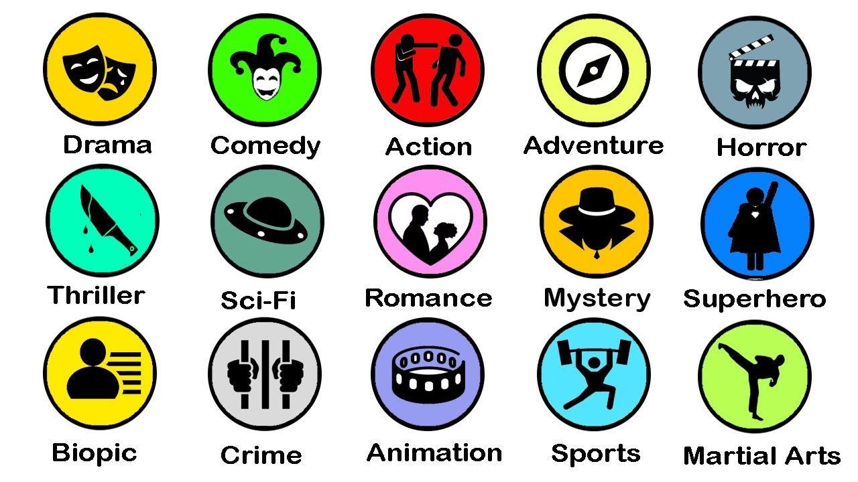
OBJECTIVE
To build a model that can predict box office success for a movie before release.
Classify movies into Hit, Average, or Flop categories.
To identify which factors contribute most to movie success.
To analyze trends that studios can use for better planning.
Use EDA to discover patterns and insights in movie performance.

Slide 3
DATASET OVERVIEW
Dataset Description
The dataset contains movie-related features such as Duration ,Language, Actor name, Gross, Budget, Director Name, Genre and Rating.
It has initially 5043 number of movies with 28 different features.
Preprocessing Steps
Handled missing values for gross and budget metrics.
Sorted out movies according to their genre types.
Used Z score to drop the outliners to get 3630 number of movies as cleaned data points.
Created IMDB score-based labels (Hit / Average / Flop).

Slide 4
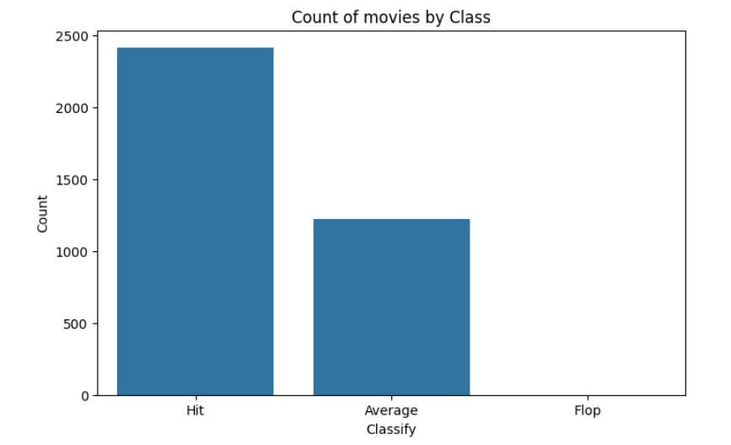
Labelling Criteria
Flop: IMDB score ranges 1-3
Average: IMDB score ranges 3-6
Hit: IMDB score ranges 6-10
Creating Hit / Average / Flop Classification
Distribution:
Hit – 2411
Average – 1219
Flop - 0
As lowest IMDB score of a movie is 3.3, no movie classified as FLOP.

Slide 5
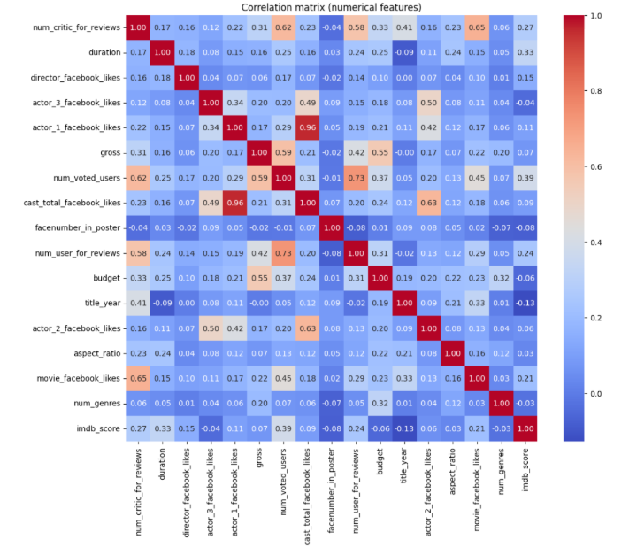
EDA (Exploratory Data Analysis)
IMDB score distribution histogram.
No. of movies every year bar chart.
Genre-wise movies released every year.
Heatmap of feature correlations.
Findings:
Comedy movies are released mostly.
Year 2010 has the highest no. of movies released.
Crime genre shows the highest IMDB score.
As of Heatmap:
Selected Columns for model evaluation which has imdb_score<=0.15 to get at least 5 features.
Those are 'num_critic_for_reviews’, 'duration’, 'num_voted_users’, 'num_user_for_reviews’, 'movie_facebook_likes’ , 'director_facebook_likes’.

Slide 6




MODEL BUILDING AND SELECTION
LOWER THE MSE AND MAE BETTER THE PERFORMANCE
Models Used:
Applied Linear regression, Decision Tree regression, Support Vector regression and KNN regression models for MSE and MAE.
Applied Logistic Regression, SVC, KNN, Decision Tree, Random Forest models to predict movie success.
Metrics Evaluated:
Mean Squared Error (MSE) measures the average of the squared differences between predicted values and actual values. It penalizes bigger mistakes more heavily than smaller ones.
Mean Absolute Error (MAE) measures the average of the absolute differences between predicted values and actual values. It tells you how far off your predictions are on average, without considering direction (no positive/negative effect).
Conclusion: Linear Regression model seems to perform best among all with MSE = 0.71 and MAE = 0.66.

Slide 7
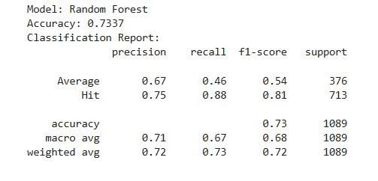
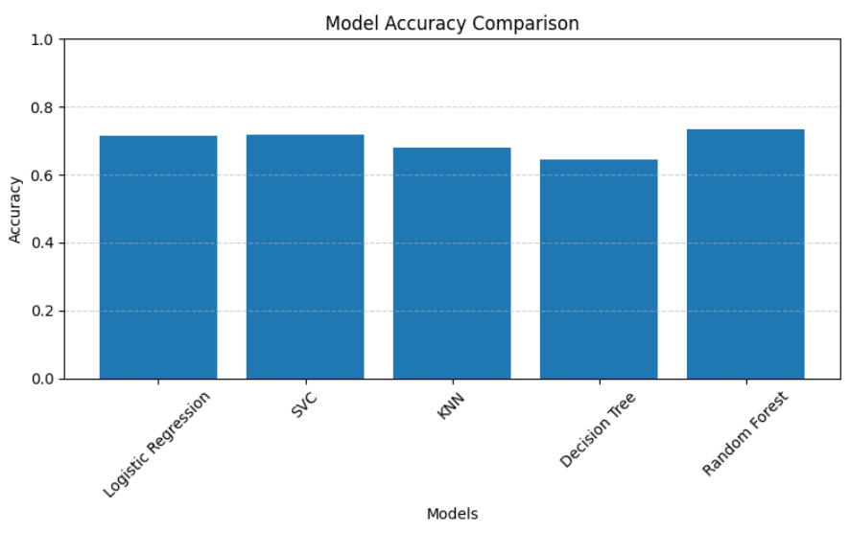
Other Metrics Evaluated:
Accuracy - Measures the percentage of all movies that were correctly classified into Hit, Average, or Flop.
Precision - Measures how many movies predicted as a certain class (Hit / Average / Flop) were actually that class.
Recall - Measures how many actual movies of a certain class the model successfully captured.
F1-score - A balance between precision and recall. Useful when both false positives and false negatives are important.
Model Performance:
Final Model
Among all the models I tested, Random Forest performed the best. It gave the highest F1-score which means it was the most accurate in classifying movies and predicting its success while maintaining a good balance between precision and recall.

Slide 8
CONCLUSION
The Random Forest classifier achieved 73% accuracy in predicting whether a movie becomes a Hit, Average, or Flop.
This indicates that the model correctly classifies about 3 out of every 4 movies.
OTHER IMPACTS
Production Optimization: The model will help identify factors influencing movie success, allowing for more informed decisions in movie production.
Marketing Strategy: Accurate prediction of movie success can assist in tailoring marketing efforts and budget allocation.
Industry Insights: Understanding success patterns can guide future trends and innovations in filmmaking.
FUTURE ENHANCEMENTS
Add marketing spend data.
Use NLP on reviews and social media posts.
Explore deep learning models (LSTM, Transformers).
Improve balancing of classes for sharper Hit/Flop distinctions.

Slide 9
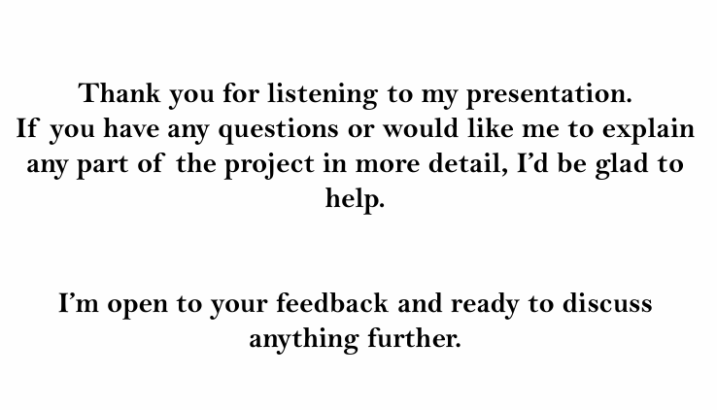
Questions ?

Slide 10
Thank You!

